Slide 1
COMNET: An Introduction
Presentation to NYSERDA
Ron Nelson, IMT
Cliff Majersik, IMT
November 3, 2010

Slide 2
What is COMNET?
COMmercial Energy Services NETwork is a new system assessing the energy efficiency of commercial and multifamily buildings
The commercial building sister to the Residential Energy Services Network—RESNET
Standardizes the process of performing energy calculations by:
Restricting schedules and other operation assumptions
Accurately specifying the baseline building
Automatic generation of reference building
Providing credit for reductions in non-regulated energy use
COMNET is developing a quality assurance program to:
Accredit software
Accredit raters/modelers
Accredit auditors (longer term)
Seeks to be a national standard
In the long term may seek ANSI accreditation

Slide 3
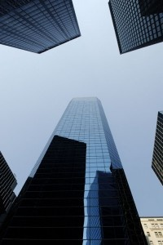
Challenges addressed by COMNET
Technical Challenges
Unregulated Loads
Plug loads, commercial refrigeration and vertical transportation.
Discrepancies between the predicted and actual energy use of a building.
Automatic Reference Building Generation
Market-Based Challenges
Skills and performance standards for building energy modeling and auditing professionals
No existing legal-grade credential

Slide 4
COMNET Technical Manual
The COMNET Modeling Guidelines and Procedures for asset ratings
Procedures for energy modeling of commercial buildings and comparing against baseline standards
Current baseline standards
Federal tax deductions (ASHRAE 90.1-2001),
Green building ratings (ASHRAE Standard 90.1-2007), and
Energy labels
Future baseline standards
Code compliance
Building energy ratings—zero energy performance index (zEPI)
Additional Possible Baselines in the Future
California code compliance (under development)
ASHRAE 90.1-2010
IgCC
IECC

Slide 5
Current Practice Vs. COMNET
Current Practice
System with COMNET

Slide 6
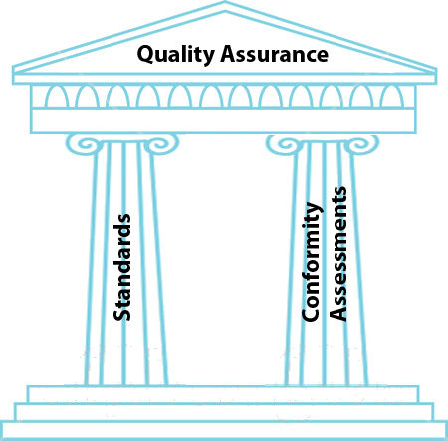
ANSI accredits organizations—goal for COMNET
To develop standards
Openness
Broad representation
Public review
Document maintenance
To certify products or personnel
Openness
Fairness
Testing
Due process for grievances
ANSI requires quality assurance
Standards
Conformity assessment

Slide 7
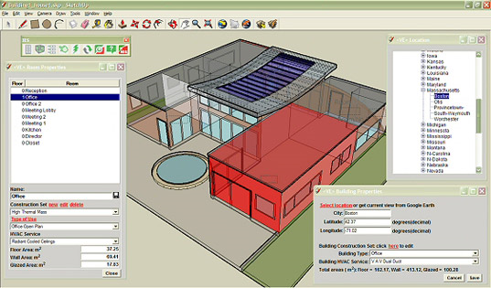
Credentialing for commercial building modelers
Drivers
No national standard—chaotic competing standards
Non-uniform prerequisites
Inconsistent body of knowledge
Different examination procedures
Varying recertification requirements
No alternatives to licensed professionals
Either a licensed engineer or architect is required for building energy modeling
High costs act as barrier to wide implementation of modeling
Unacceptable for mandatory program
Weak or nonexistent quality assurance mechanisms
No verification of adherence to modeling standards
No risk for loss of certification for modelers

Slide 8
Opportunity for COMNET credential
Oversight of quality assurance of certified professionals
Industry standards for professional conduct
Professional accountability through different levels of discipline such as probation, suspension, and revocation
Standard for continuing education and recertification processes
Random audits of certified building modelers
Third-party verification of quality assurance performance
Optional third-party training and continuing education providers

Slide 9
Benefits of COMNET
Benefits to Rating Authorities
More confidence in the results
Less time required to review submittals (lower cost)
Data flows seamlessly into the rating authorities database
No “gaming” of the system
Process is adaptable to new and changing baselines
Benefits to the building owners
Standardized method to get an accurate, reliable asset rating
Standards and assumptions that allow for apples to apples comparison between buildings
Cost savings for asset rating and code compliance through automatic generation of the reference building

Slide 10
Benefits of COMNET (cont)
Benefits to Energy Modelers
Less effort, a more error free process
Baseline building is automatically generated
Only need to specify the proposed design
Offers credit for reductions in non-regulated energy use such as commercial refrigeration and plug loads
Same COMNET accredited software can be used for multiple purposes
Tax credits
Green building ratings
Energy labels
Code compliance (future)
Benefits to Software Developers
Single specification serves multiple purposes-Tax credits, Green building ratings, Energy labels and Code compliance (future)
Reduced development costs
Credibility from third-party

Slide 11
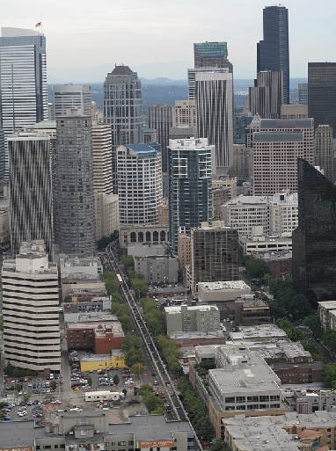
Potential Applications
Document compliance to qualify for
EPACT 2005 Energy Efficient Commercial Buildings Tax Deduction
Performance-based energy code compliance
Generating estimates of operating costs for commercial building appraisals
Enabling comparison of “designed-performance” energy efficiency ratings among buildings
USGBC’s LEED™ NC energy points
Producing EUI outputs specifically for ENERGY STAR’s Target Finder™
Integration into ASHRAE technical specs (COMNET is referenced by ASHRAE Building Energy Quotient—bEQ)
Utility, State or Federal performance-based incentive programs

Slide 12
Application in New York State— the Green Building Tax Credit
Energy and energy efficiency:
New construction: no more than 65% of energy use allowed under The New York State Energy Conservation and Construction Code
Rehabilitation: no more than 75% of energy use allowed under The New York State Energy Conservation and Construction Code
Other standards set by Department of Environmental Conservation in effect at time placed in service.
Appliances and any heating, cooling and water heating equipment.
Other green requirements
Compliance with other requirements: zoning, land use, erosion control, storm water management, building code, environmental regulations.
Indoor Air Quality
Fresh air intake located away from sources of contamination.
Indoor air quality management plan during construction or rehabilitation.
Annual Indoor Air Quality testing: Carbon monoxide, carbon dioxide, volatile organic compounds, radon, and particulates (OK to do radon once).
Mechanical Plant Commissioning.
Facilitating recycling of wastes.
Energy compliant plumbing fixtures.
Notices to tenants of tax credit opportunity and guidelines for energy efficiency air quality and recycling.
Building Materials, Finishes and Furnishings.
Owner occupied tenant space must be green if owner wants credit

Slide 13
Status of the COMNET project
Work performed within committees
Charles Eley, Chair (AEC)
Bill Prindle (ICF)
Jean Lupinacci (EPA)
Martha Brook (CEC)
Michael Holtz (LightLouver)
David Goldstein (NRDC)
Steve Taylor (Taylor/ASHRAE)
Mike Opitz (USGBC)
Philip Fairey (FSEC)
Cliff Majersik (IMT)
Colin McCormick (DOE)
C S C
TECHNICAL
SOFTWARE ACCREDITATION
CREDENTIALING
STRUCTURE
AND FINANCE
PROMOTION
Charles Eley
Michael Holtz
Philip Fairey
Steve Taylor
Martha Brook
David Goldstein
Charles Eley
Michael Holtz
Philip Fairey
Steve Taylor
Colin McCormick
Cliff Majersik
Philip Fairey
Bill Prindle
David Goldstein
Chip Barnaby
Roger Hedrick
Ann McCormick
Asim Tahir
David Goldstein
Michael Holtz
Philip Fairey
Cliff Majersik
Steve Baden
Cliff Majersik
Jean Lupinacci
Colin McCormick
Martha Brook
Mike Opitz

Slide 14
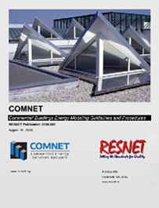
Status of the COMNET project (cont)
Technical Committee
Completed modeling and guidelines procedures
Reviewed document through two public comment periods
Published completed document on August 16
Credentialing Committee
Looking at building energy modeler first
Assessing body of knowledge
ASHRAE’s Building Energy Modeler Professional (BEMP) looks like a good precedent
Incremental body of knowledge appears small
Tentatively regards BEMP as sufficient credential for modeling skills
No further testing required for modeler using accredited software
Training and testing required for modeler using unaccredited software
Conformity assessment required for all COMNET modelers
Random third-party verification from credentialed verifiers

Slide 15
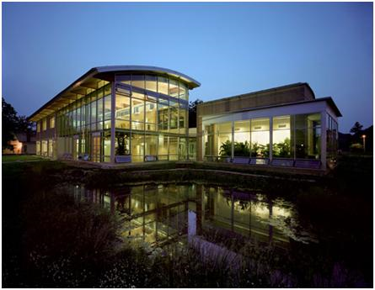
Status of the COMNET project (cont)
Promotion Committee
Includes major stakeholders
DOE
EPA
CEC
USGBC
Work in progress
Defining partnerships
Engaging software vendors
Structure and Finance Committee
Considering three organization options
Coordinating with RESNET’s future positioning task force
Software Accreditation Committee
Not yet convened

Slide 16
Project Team
Project Management
New Building Institute
Institutional Lead
Institute for Market Transformation
RESNET
Technical Lead
Architectural Energy Corporation
Energy Soft
Florida Solar Energy Center
Energy and Environmental Economics
McHugh Energy Consultants
National Resource Defense Council

Slide 17
Conclusion
COMNET Guidelines and Procedures complete and ready to reference
COMNET credentialing processes under development
COMNET integration with RESNET in progress

